Slide 1
Chapter 2
T-SQL Programming

Slide 2
Review
Review of Database Design:
Definition of Database Design
Need for Database Design
Basics of Database Design
E-R diagrams, Normalization and data dictionary

Slide 3
Objectives
Understand the concepts of batch and Batch Processing
Write SQL login control statements to express application logic
Define and assign variables
Write SQL statements using SQL Server basic functions
Use basic functions in a query

Slide 4
Introduction to SQL Batch Processing
Individual SQL commands
Batch
Grouped to form a batch
Compiled as single execution plan
Output/Result

Slide 5


Definition
The process wherein a set of
commands are processed one
at a time from a batch of
commands is called
Batch processing.

Slide 6
Example of a batch
Use Pubs
Select * from authors
Update authors
set phone= '890 451-7366‘
where au_lname= 'White'
Go
Signals end of a batch

Slide 7
Comments in a batch
Comments
Text strings in program code (also known as remarks) that will be ignored by the compiler.
Used to document code or temporarily disable parts of Transact-SQL statements and batches being diagnosed.
Makes maintenance of program code easier.
Comments are often used to record the program name, the author name, and the dates of major code changes.
Comments can be used to describe complicated calculations or explain a programming method.

Slide 8
Comment Styles
SQL Server supports two types of commenting styles:
1) --(double hyphens)
For example:
USE Northwind
GO
-- First line of a multiple-line comment.
2) /* ... */ (forward slash-asterisk character pairs)
For example:
SELECT * FROM Employees /*This is a comment*/

Slide 9
Multi line comments
Multiple-line /* */ comments cannot span a batch. The complete comment must be contained within a batch.
For example, in SQL Query Analyzer, the GO command signals the end of a batch. When the utilities read the characters GO in the first two bytes of a line, they send all the code since the last GO command to the server as one batch.
If a GO occurs at the start of a line between the /* and */ delimiters, then an unmatched comment delimiter will be sent with each batch and they will trigger syntax errors.

Slide 10
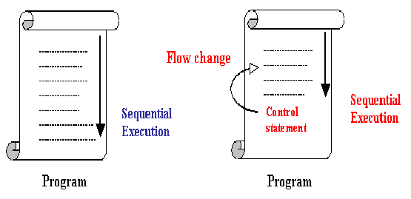
Control Statements

Slide 11
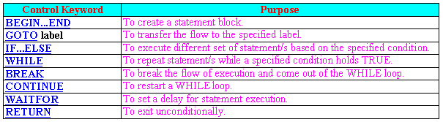
Control Statements Contd…

Slide 12
BEGIN..END
BEGIN...END : A set of TSQL statements to be executed can be enclosed in BEGIN..END.
Syntax:
BEGIN
{
statement | statement_block
}
END

Slide 13

IF..ELSE
IF...ELSE: We can execute different
sets of SQL statements based on
specified conditions.
Syntax:
IF Boolean_expression
{ sql_statement | statement_block }
[ ELSE
{ sql_statement | statement_block } ]
IF statement
TRUE
FALSE

Slide 14
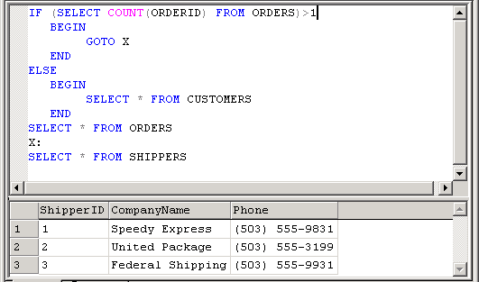
Example for IF

Slide 15


The WHILE construct
WHILE: We can execute a SQL statement or a
block of statements based on some condition. The
statements are repeatedly executed WHILE the
specified condition holds true.
Syntax:
WHILE Boolean_expression
{ statement | statement_block }
[ BREAK ]
{ statement | statement_block }
[ CONTINUE ]

Slide 16
BREAK and CONTINUE
We can use CONTINUE and BREAK keywords within the while loop to control the execution of statements.
USE pubs
GO
WHILE (SELECT AVG(price) FROM titles) < $30
BEGIN
UPDATE titles
  SET price = price * 2
SELECT MAX(price) FROM titles
IF (SELECT MAX(price) FROM titles) > $50
  BREAK
ELSE
  CONTINUE
END
PRINT 'Too much for the market to bear'

Slide 17
GOTO keyword
GOTO:
We can change the flow of execution to a specified location (label). The statements after GOTO keyword are skipped and the execution process continues at the specified label in the GOTO statement.
Syntax:
GOTO label

Slide 18
RETURN
RETURN: We can use RETURN at any point to exit from a block, procedure. Statements after the RETURN statement are not executed.
Syntax:
RETURN [ integer_expression ]

Slide 19
CASE statement
CASE: The CASE keyword allows us to return a value based on whether an expression is true. It can be used wherever an expression is allowed.
Syntax:
CASE expression
WHEN expression1 THEN expression1
[[WHEN expression2 THEN expression2] […]]
[ELSE expression]
END
Example:
SELECT au_fname, au_lname, CASE state WHEN 'OR' THEN 'Oregon' END AS StateName FROM authors

Slide 20
Multi column updates using CASE
UPDATE publishers
SET state =
CASE
WHEN country <> "USA"
THEN "--"
ELSE state
END,
city =
CASE
WHEN pub_id = "9999"
THEN "LYON"
ELSE city
END
WHERE country <> "USA" OR
pub_id = "9999"
Two or more columns can be updated using one command in this manner

Slide 21
Local Variables
A variable is an object that can hold a data value
Data can be passed to SQL statements using Local Variables
The name of the local variable must be prefixed with '@' sign
SET or the SELECT statement is used to assign some value to the local variable
Example :
DECLARE @cust VARCHAR(20)
SET @cust= 'FRANK'

Slide 22
Assigning values to variables
The SET statement or the SELECT statement is
used to assign some value to the local variable.
Syntax: SET @local_variable name = value
OR
SELECT @local_variable name = value
For example, let us assign a value to the variable declared earlier.
SET @CUST=’FRANK’
SELECT CUSTOMERID,COMPANYNAME FROM CUSTOMERS WHERE CUSTOMERID = @CUST

Slide 23
Variables
SQL Server supports two types of variables in
T-SQL:
Global variables
Local variables

Slide 24
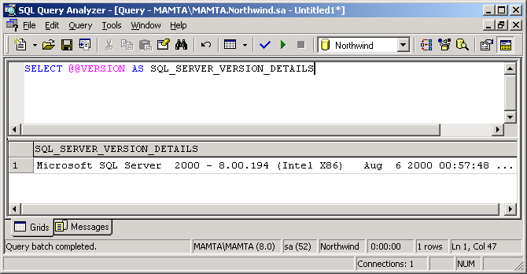
Global variables
Global variables in SQL Server are all prefixed with two @ SIGNS. We can retrieve the value of any of these variables with a simple SELECT query

Slide 25
List of Global variables
Variables Meanings
@@CONNECTIONS Number of connections made to the server since it was last started.
@@CPU_BUSY Number of milliseconds the system has been processing since SQL Server was started
@@CURSOR_ROWS Number of rows in the most recently opened cursor.
@@DATEFIRST The current value of SET DATEFIRST parameter which controls the first day that’s considered to be the first day of the week.
@@ERROR Error number of the last T-SQL error
@@FETCH_STATUS 0 if the last fetch status was successful. -1 if there was an error

Slide 26
List of Global variables Contd…
Variables Meanings
@@IDENTITY Last inserted identity value
@@LANGUAGE Name of the language currently in use.
@@MAX_CONNECTIONS Maximum number of concurrent connections that can be made.
@@ROWCOUNT Number of rows affected by most recent SQL Statement
@@SERVERNAME Name of local server
@@SERVICENAME Name of the SQL Service on this computer
@@TIMETICKS Number of microseconds per tick on the current computer
@@TRANSCOUNT Number of transaction open on the current connection
@@VERSION Version information of SQL Server

Slide 27
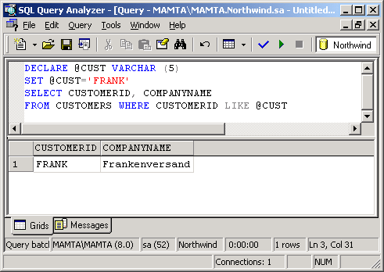
Defining and assigning local variables

Slide 28
Functions
Functions can be classified into three types:
- Rowset Functions
- Aggregate Functions
- Scalar Functions

Slide 29
Conversion Functions
The conversion function is used to transform a value of one data
type to another. Additionally, we can use it to obtain a variety of
special date formats. SQL Server provides a single conversion
function, CONVERT().
Syntax:
CONVERT(datatype[(length)], expression [,style])
Example:
SELECT ‘EMP ID:’ + CONVERT (CHAR(4), EMPLOYEEID FROM EMPLOYEES

Slide 30

Date Parts
DatePart Abbreviation Values
Hour hh 0-23
Minute Mi 0-59
Second Ss 0-59
Millisecond Ms 0-999
Day of year Dy 1-366
Day Dd 1-31

Slide 31
Date Parts Contd…
Datepart Abbreviation Values
Week wk 1-53
Weekday dw 1-7
Month mm 1-12
Quarter qq 1-4
Year yy 1753-9999

Slide 32
Date and Mathematical functions
Date Functions
GETDATE()
DATEADD(datepart,number,date)
DATEDIFF(datepart,date1,date2)
DATENAME(datepart,date)
DATEPART(datepart,date)
Mathematical Functions
ABS(num_expr)
CEILING(num_expr)
FLOOR(num_expr)
POWER(num_expr,y)
ROUND(num_expr,length)
Sign(num_expr)
Sqrt(float_expr)

Slide 33
System functions
Function
DB_ID([‘database_name’])
DB_NAME([database_id])
HOST_ID()
HOST_NAME()
ISNULL(expr,value)
OBJECT_ID(‘obj_name’)
OBJECT_NAME(object_id)
SUSER_SID([‘login_name’])
SUSER_ID([‘login_name’])
SUSER_SNAME([server_user_id])
SUSER_NAME([server_user_id])
USER_ID([‘user_name’])
USER_NAME([user_id])

Slide 34
Aggregate functions
Function Return Value
Sum(col_name) Returns the summation of series of
values.
Avg(col_name) Returns average of a series of values.
COUNT(*) Function to retrieve the number of records in a table that meet given criteria
Max(col_name) Returns the Maximum value from a series of values.
Min(col_name) Returns the Minimum value from a series of values.

Slide 35
Summary
A batch is a collection of one or more SQL statements sent in one unit by the client.
A stored procedure is a group of T-SQL statements compiled into a single execution plan.
Comments are text strings in program code (also known as remarks) that are ignored by the compiler.
Microsoft SQL Server supports two types of commenting styles:
-- (double hyphens) and /* ... */ (forward slash-asterisk character pairs).
Control-of-flow statements provide sequencing and logic necessary for conditional processing
A variable is an object that can hold a data value. We can pass data to SQL statements using variables.

Slide 36
Summary Contd…
SQL Server supports two types of variables in T-SQL: global variables and local variables
Functions can be useful when we are calculating or otherwise manipulating data.
There are three classes of T-SQL functions:
  Rowset functions can be used in place of table names in SQL.
  Aggregate functions calculate a single number (for example a sum or a standard deviation).
  Scalar functions operate on single value, and return a single value. These are the functions that we can use in expressions.

